Slide 1
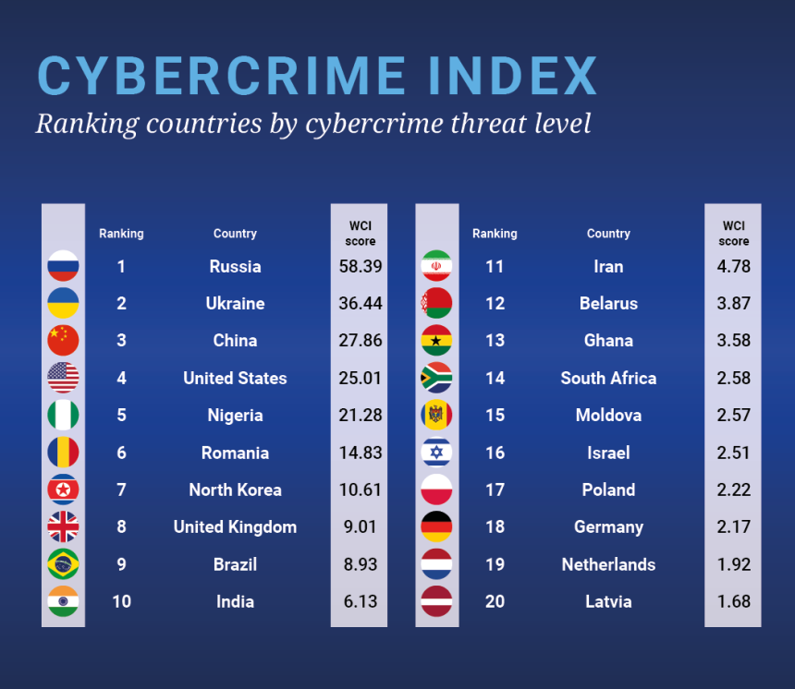

Slide 2
Headline Cyber Crime Statistics
50% of UK businesses experienced some form of cyber attack in 2023.
Nearly 1 billion emails were exposed in a single year, affecting 1 in 5 internet users.
Data breaches cost businesses an average of $4.88 million in 2024.
Around 236.1 million ransomware attacks occurred globally in the first half of 2022.
1 in 2 American internet users had their accounts breached in 2021.
39% of UK businesses reported suffering a cyber attack in 2022.
Around 1 in 10 US organisations have no insurance against cyber attacks.
53.35 million US citizens were affected by cyber crime in the first half of 2022.
Cyber crime cost UK businesses an average of £4200 in 2022.
In 2020, malware attacks increased by 358% compared to 2019.
The most common cyber threat facing businesses and individuals is phishing.

Slide 3
CYBERSECURITY AWARENESS

Slide 4

🕵️‍♂️ Two Truths and a Cyber Lie
I’ve reused the same password for five different accounts.
I’ve clicked a link from a sketchy email just to ‘see what happens.’
I’ve never used public Wi-Fi without a VPN
Which one is the lie?

Slide 5
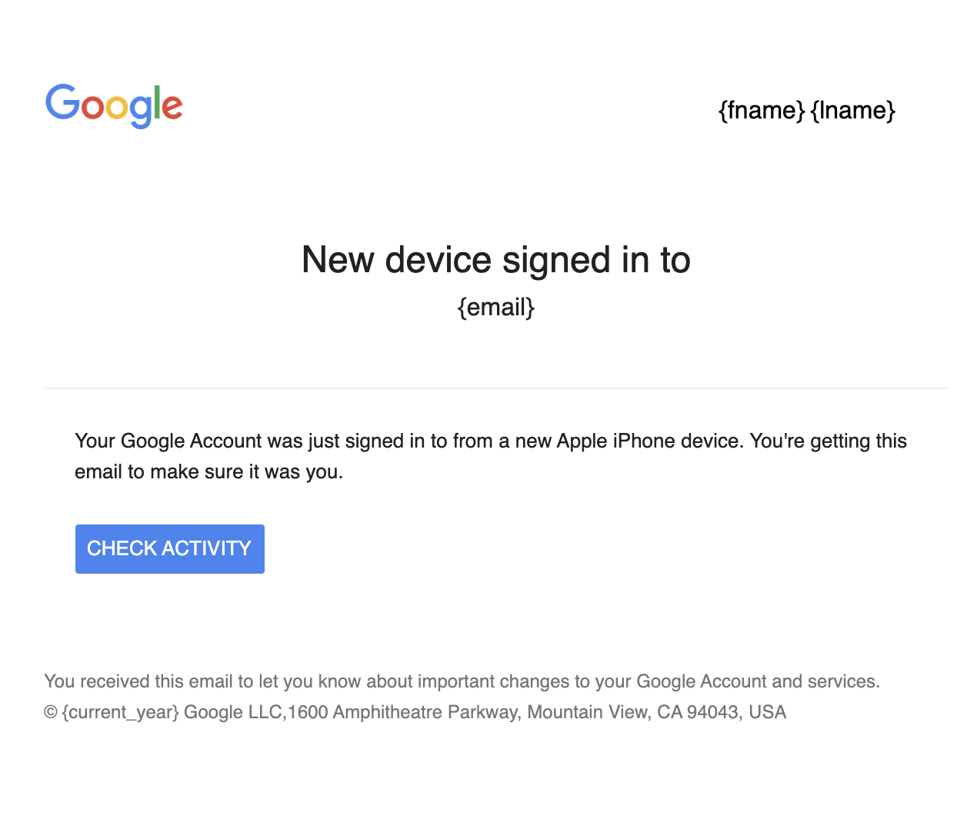
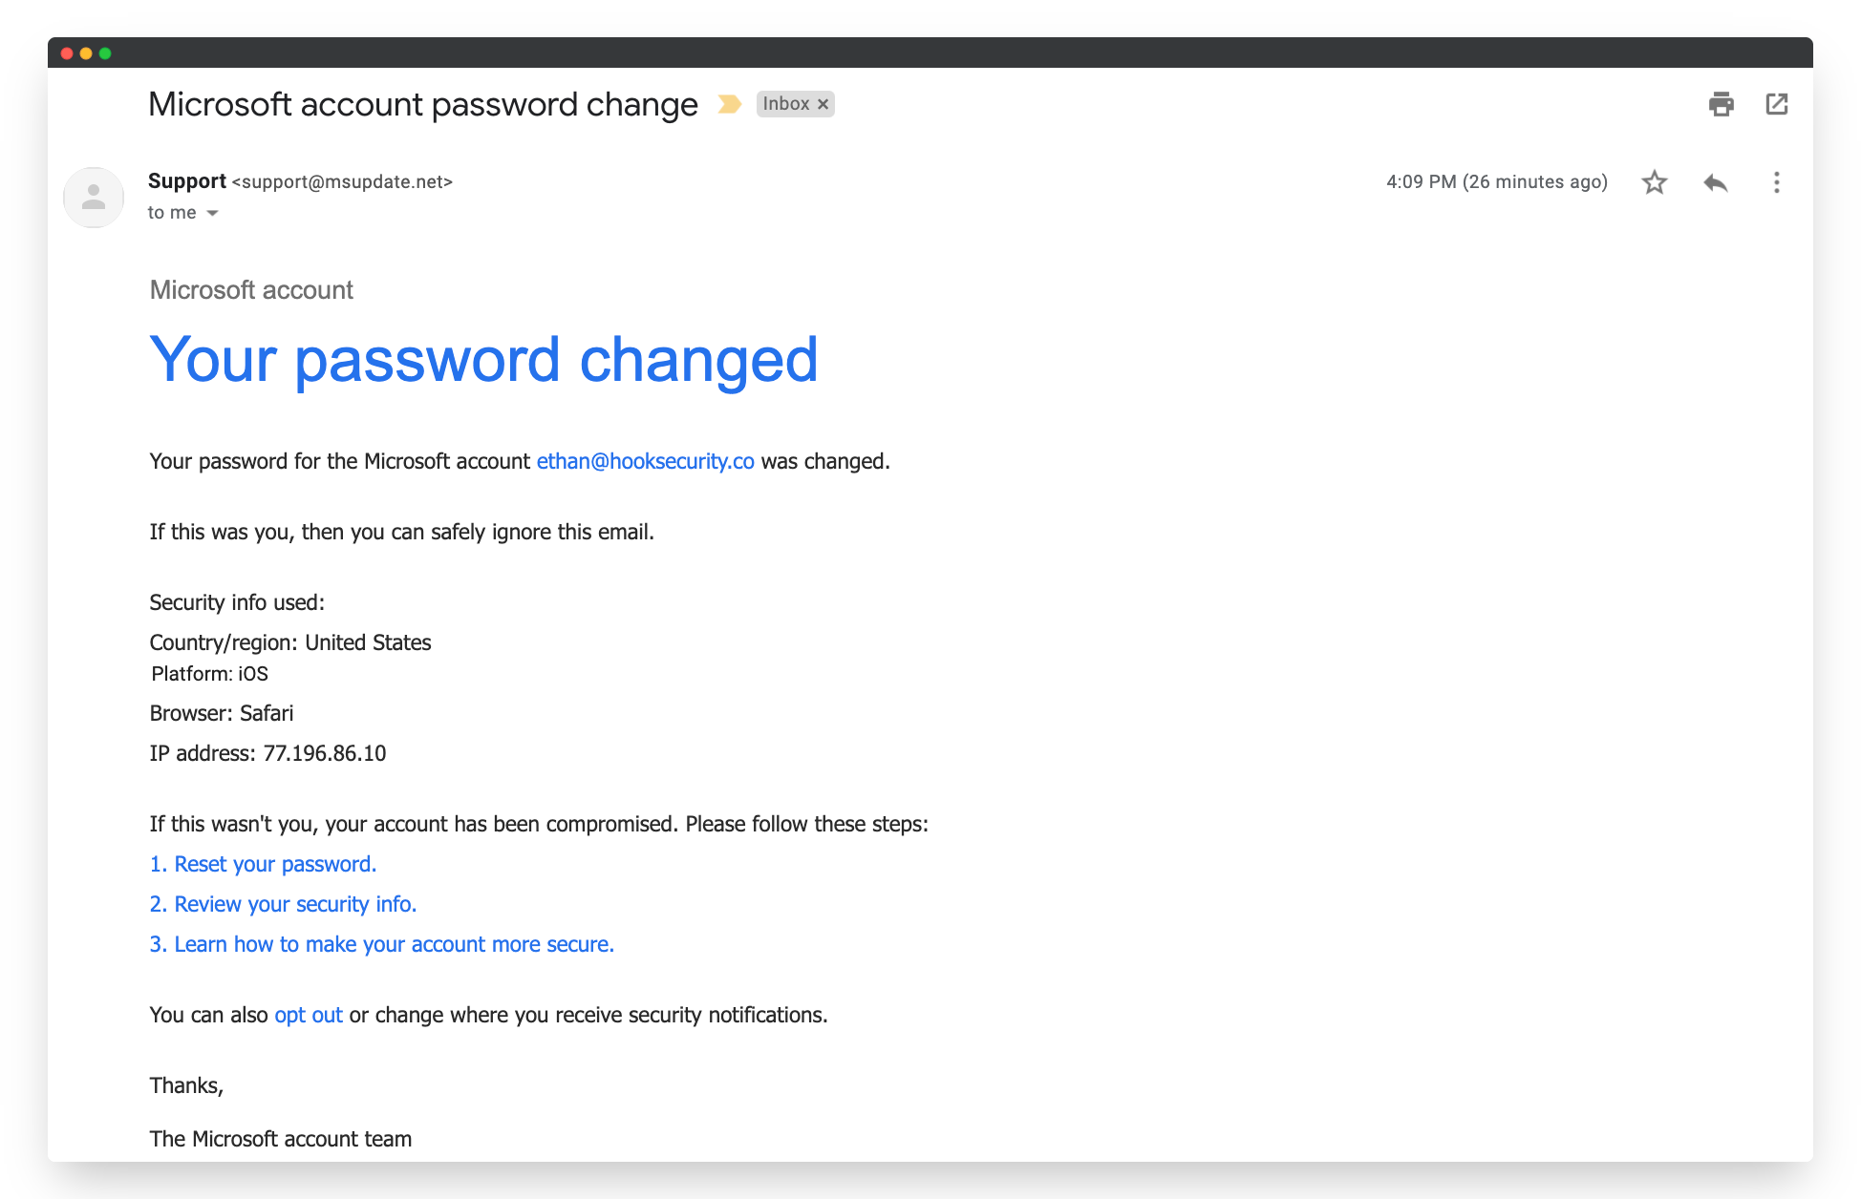

Slide 6
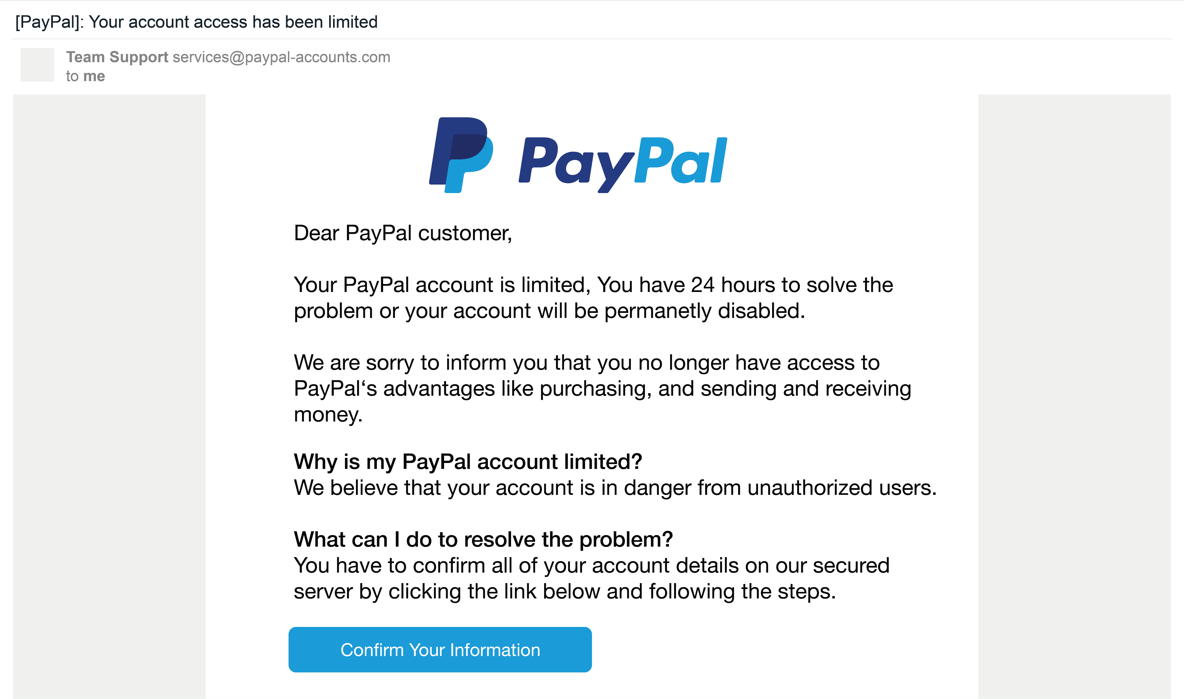
Vishing

Slide 7

Deepfake

Slide 8


123456
P@ssw0rd!
IloveJesus2024
Notes:
“Which of these passwords do you think a hacker would crack first — and why?”

Slide 9





Slide 10




Slide 11
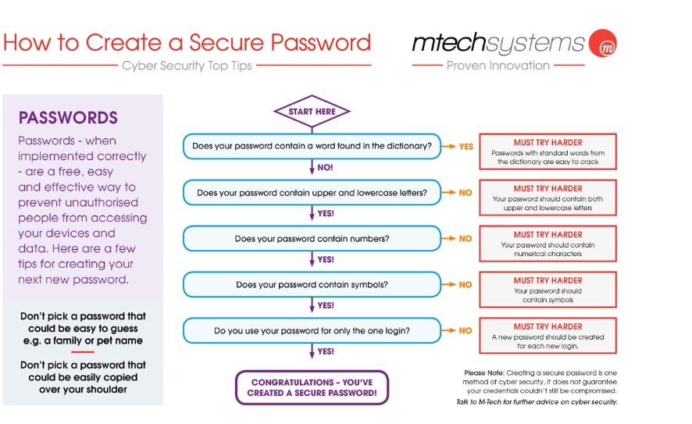

Slide 12
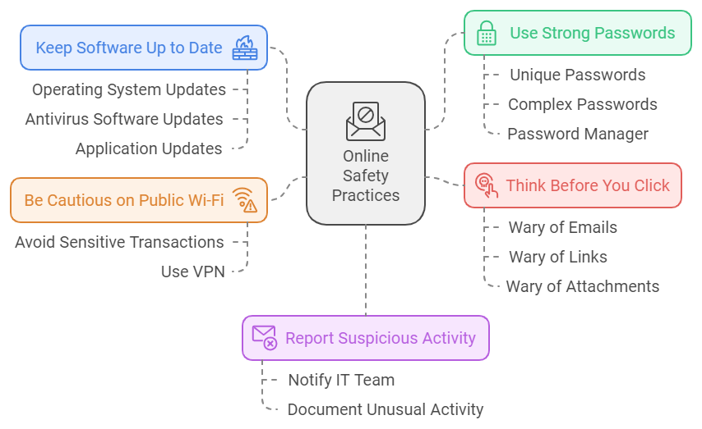

Slide 13


